Slide 1
Marin Outreach Training

Slide 2
Agenda
Searching for Clients/Creating New Profiles
Release of Information
Contact Information
Location Tab
Enrollments
  Date of Engagement
Current Living Situation
Exits
Reports
Resources
Notes:
Here is the agenda for today’s training

Slide 3
Searching for Clients and Creating Client Profiles

Slide 4
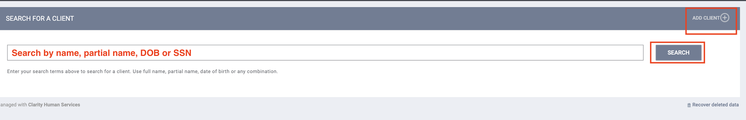
Searching for Clients
Search for client or head of household
  Search by name, partial name, DOB or SSN
If unable to find head of household, create a new profile
Notes:
To look up a client in HMIS, you can search by the client ‘s full name, partial name, DOB or social security #
Searching by partial name is helpful in case the client has an existing profile but someone spelled the name incorrectly or you aren't sure of the correct spelling.
If you don’t find a record, you will create a new one which I will show you in a couple of slides.

Slide 5
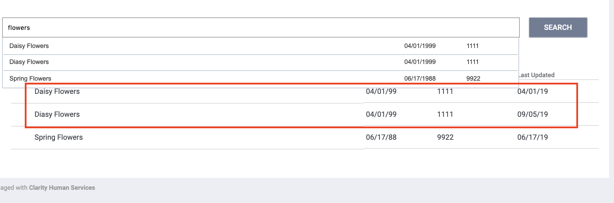
Duplicate Profiles
If you discover multiple profiles for a client, you should:
  Identify which profile should be the primary.
  Contact the Bitfocus Help Desk to get the records merged together.
    Provide the unique identifiers for each profile.
Notes:
You may run across duplicate records for a client. You tell if all of the information is the same except one small thing. In this screenshot, you can see that the DOB, SSN are the same and the name is almost identical except for one record Daisy is spelled incorrectly.
This is an example of a duplicate.When you find duplicate records, we want to get the merged together so there is only one record for the client. You can contact the BF Help Desk to get duplicate records merged together.
You will need to provide the unique ID # for each record.

Slide 6
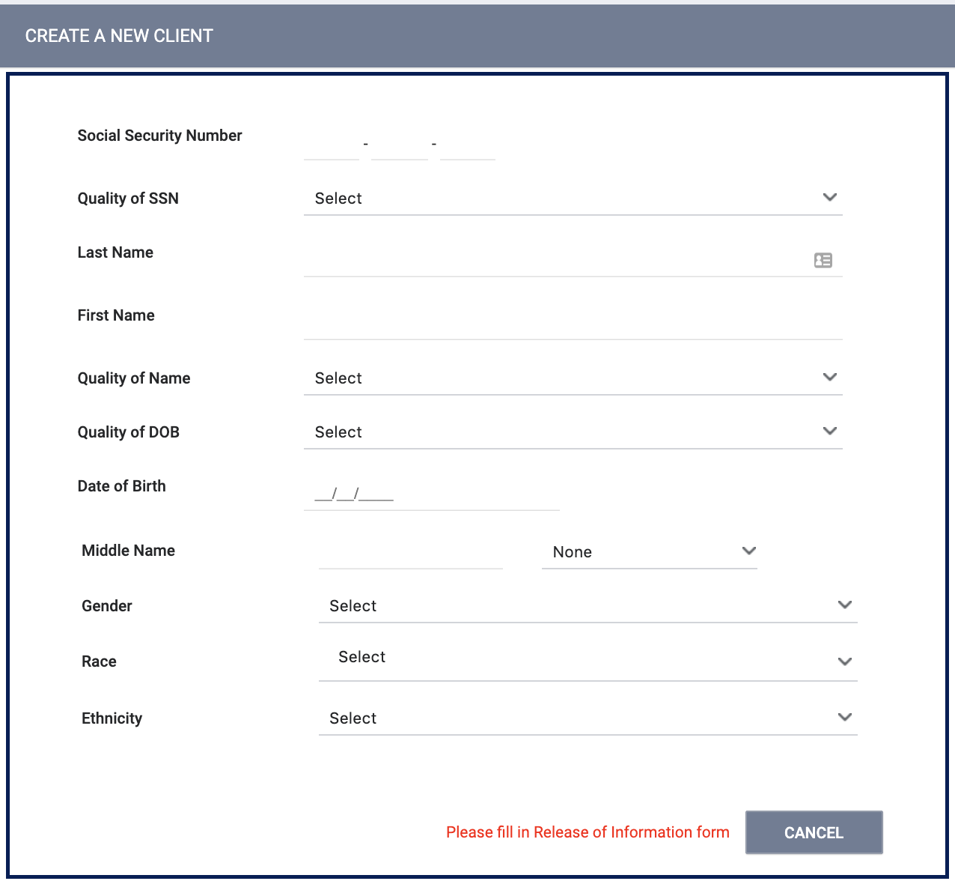
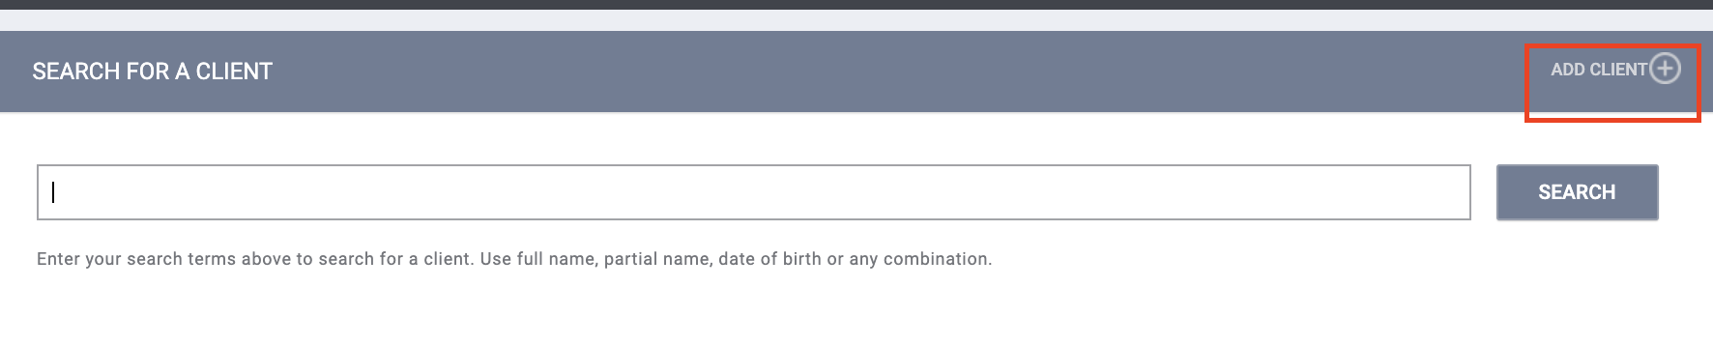
Creating New Profiles
Building rapport with a client takes time so attempt to collect as much information as possible.
  Avoid using “Client refused” or Data Not Collected” whenever possible.
  Enter partial information and use the alias field when appropriate.
  Update the profile as you learn more about the client.
For existing profiles, confirm that all information is correct.
Notes:
Building rapport when doing outreach takes time. Gather as much information as the client is willing to share. As you learn more about the client over time, update the profile with additional information.

Slide 7
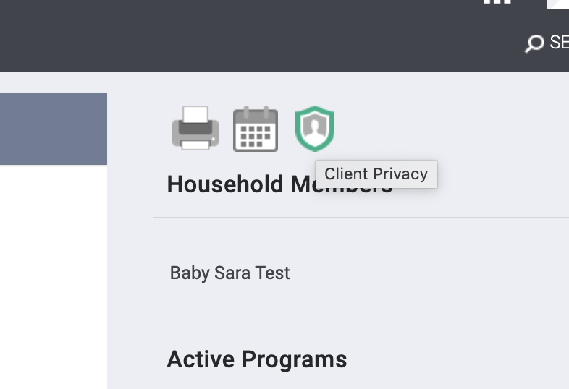
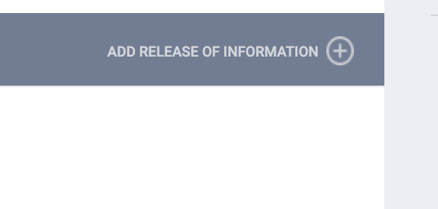
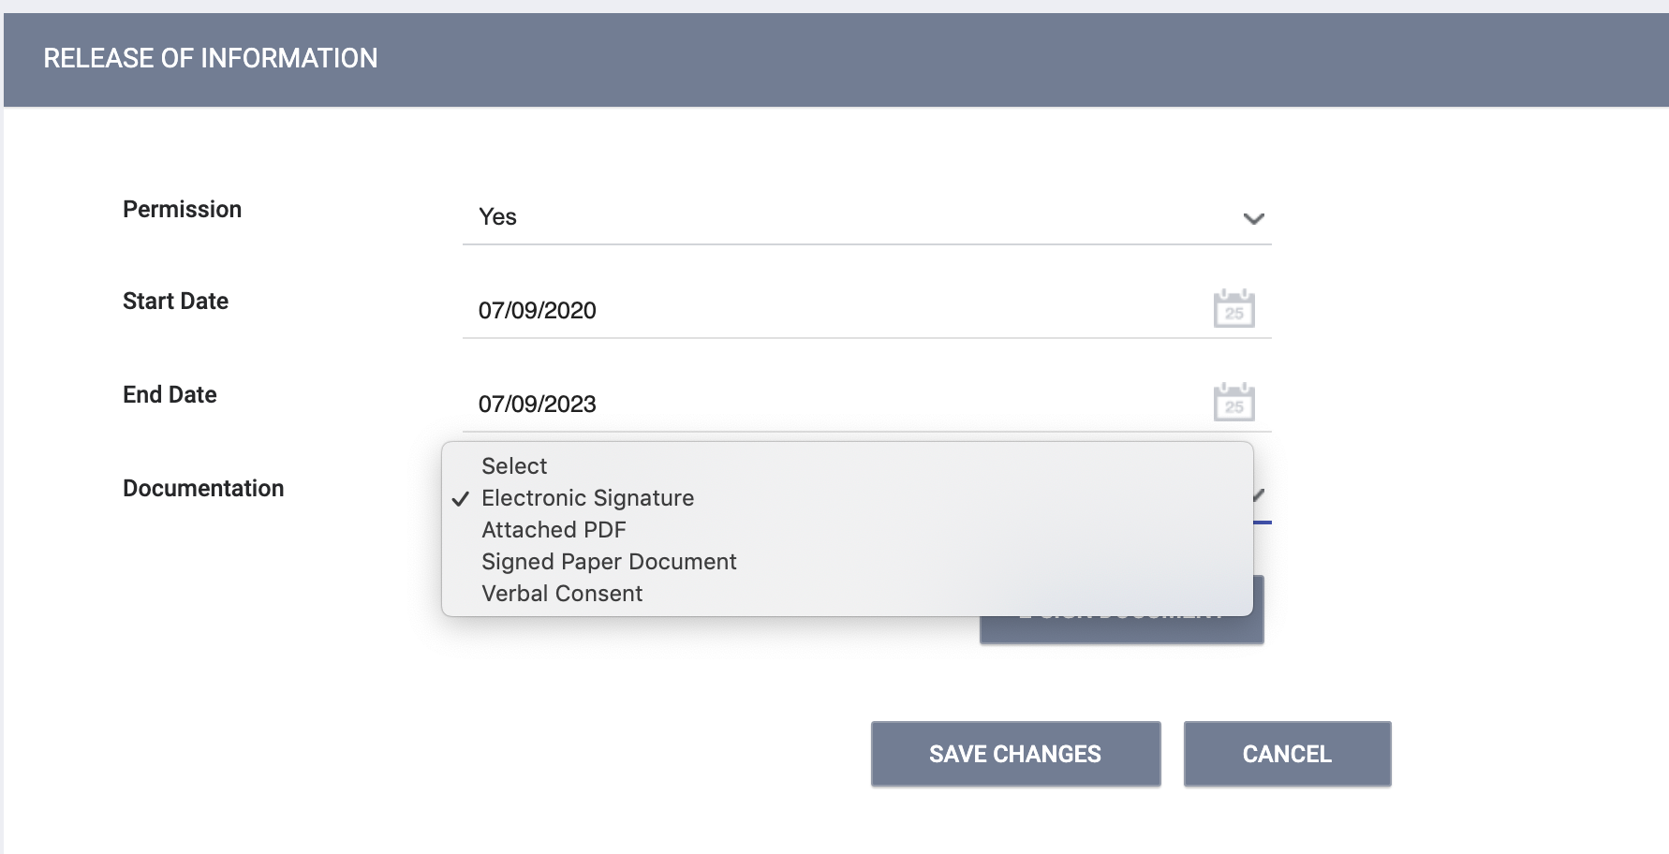
Release of Information (ROI)
A release of information should be added for every client.
You can upload a signed PDF or complete by E-signing.
Notes:
An ROI should be added for every client, including minors.

Slide 8
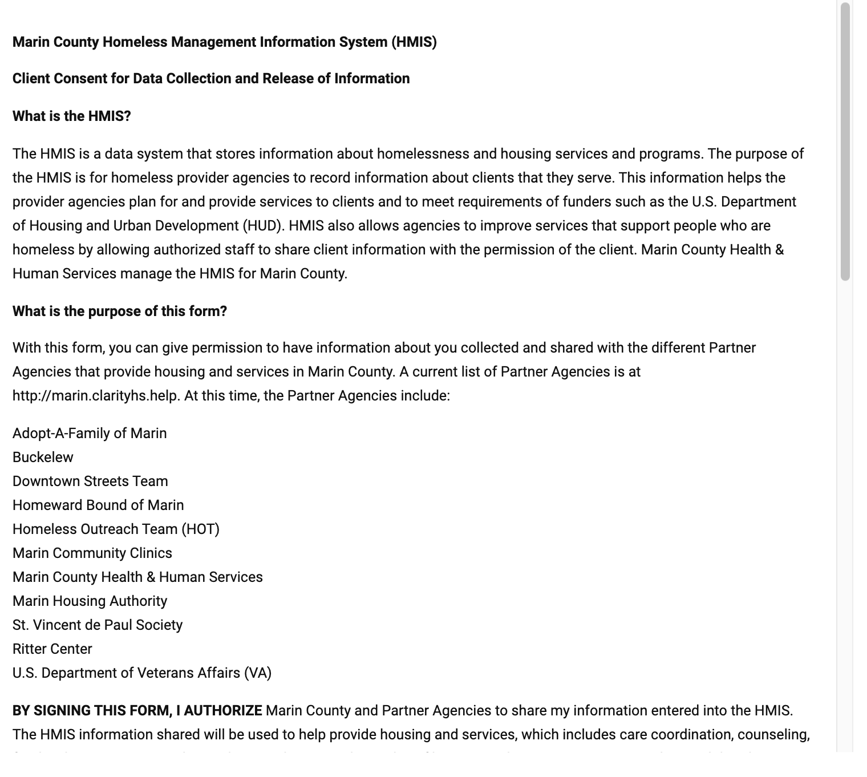
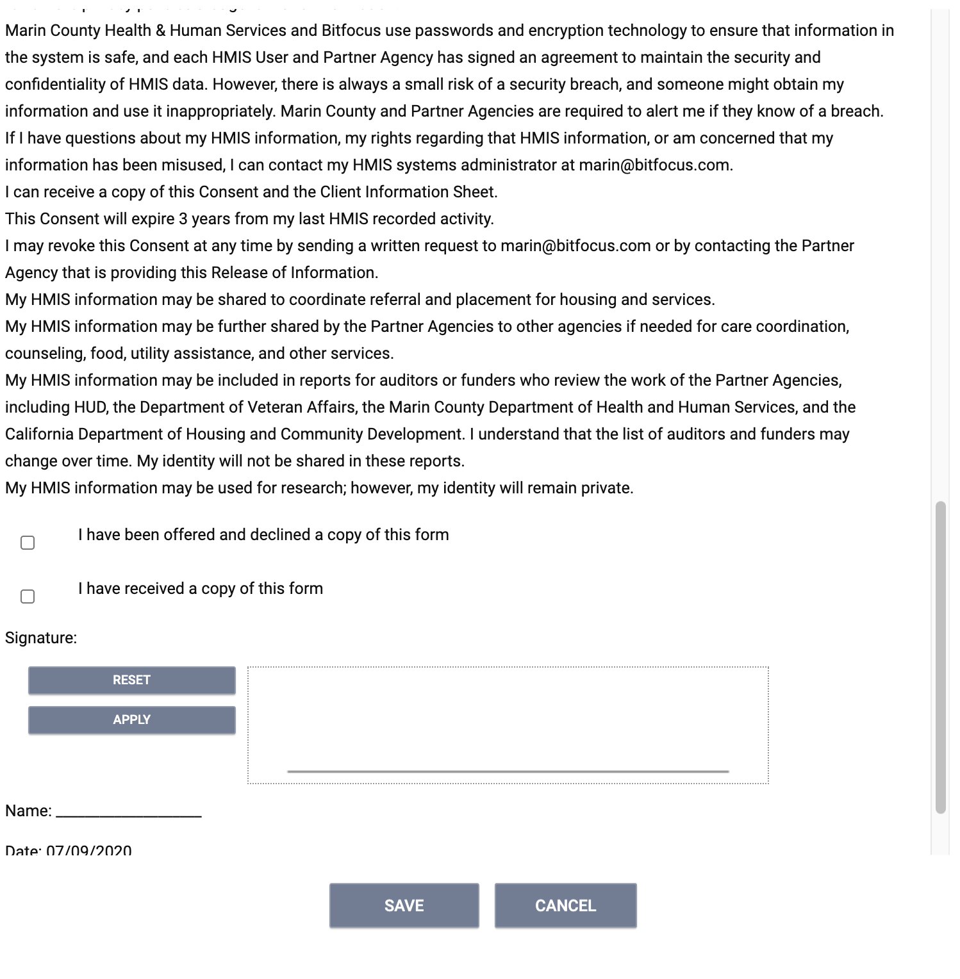
Release of Information (ROI)
E-Signature

Slide 9
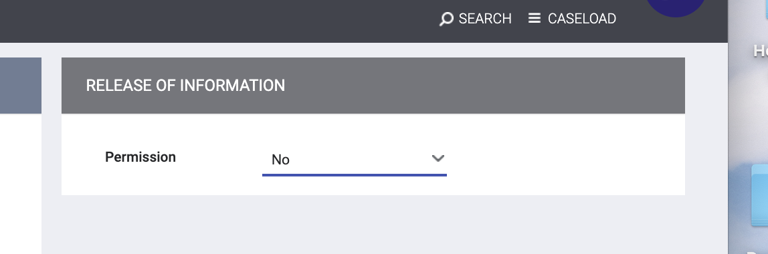
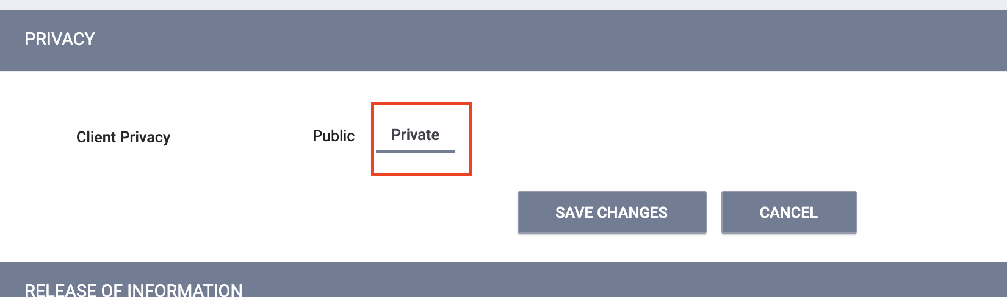
Release of Information (ROI)
If the client does not consent, you should set the ROI permission to “No” and mark the record “Private”.
We always want to encourage the client to consent when possible. This increase coordination of care.
Notes:
There are times when a client will not agree to sign the ROI. This is especially true when doing outreach since it can take time to build trust and rapport with clients. Marking a record private, only allows that record to be visible to the agency who created the profile. This method allows us to enter information about the client into HMIS without sharing their information with other agencies.
You will want to encourage the client to sign the ROI over time. If they eventually agree, you will want to change update their record from private to public.

Slide 10
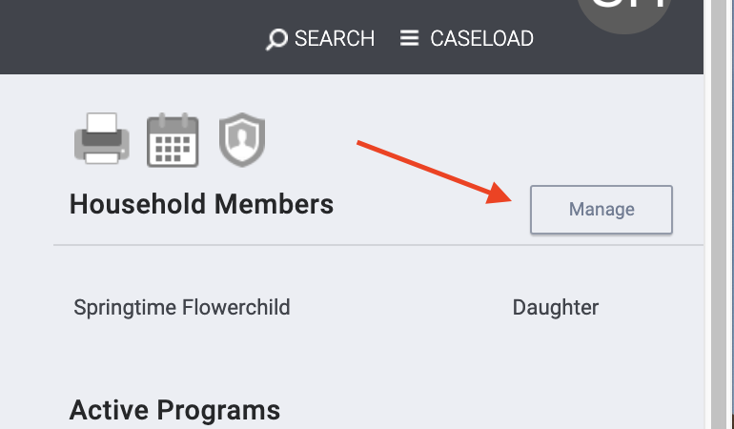
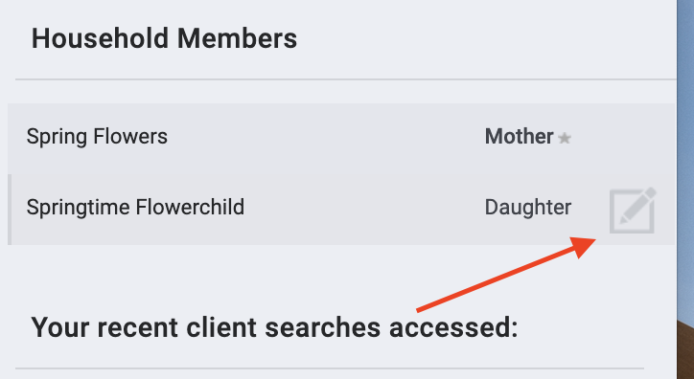
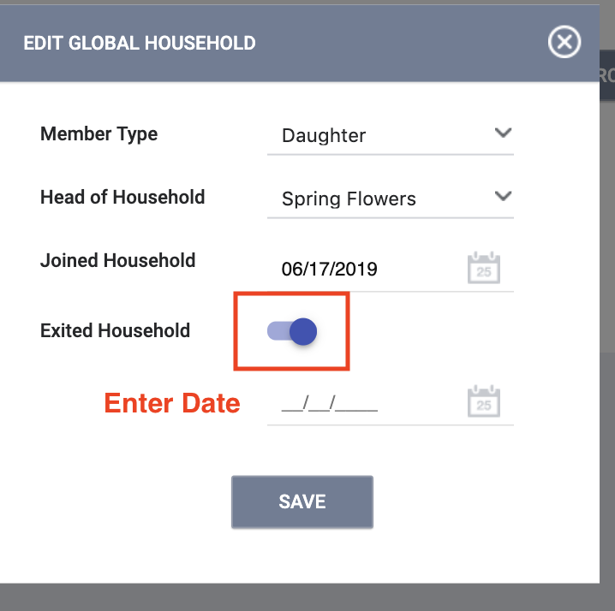
Managing Households
Clients in the same “family” should be in a household in HMIS.
The household composition can be updated if things change.
1
2 3
Notes:
There are times when a household composition may change. You will want to add or remove records from the household when that occurs.

Slide 11
Contact and Location Tab

Slide 12
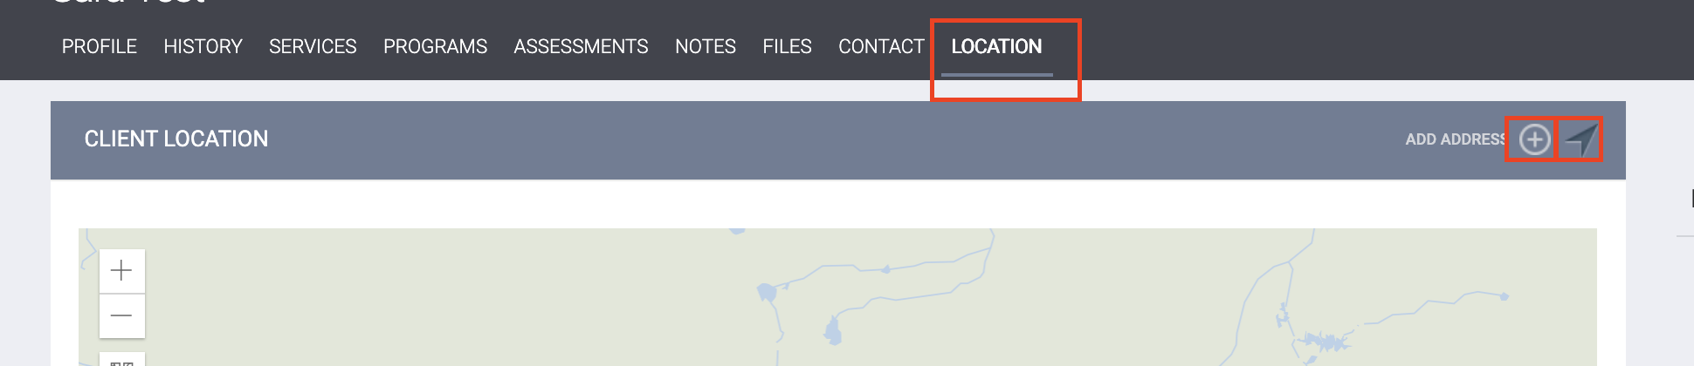
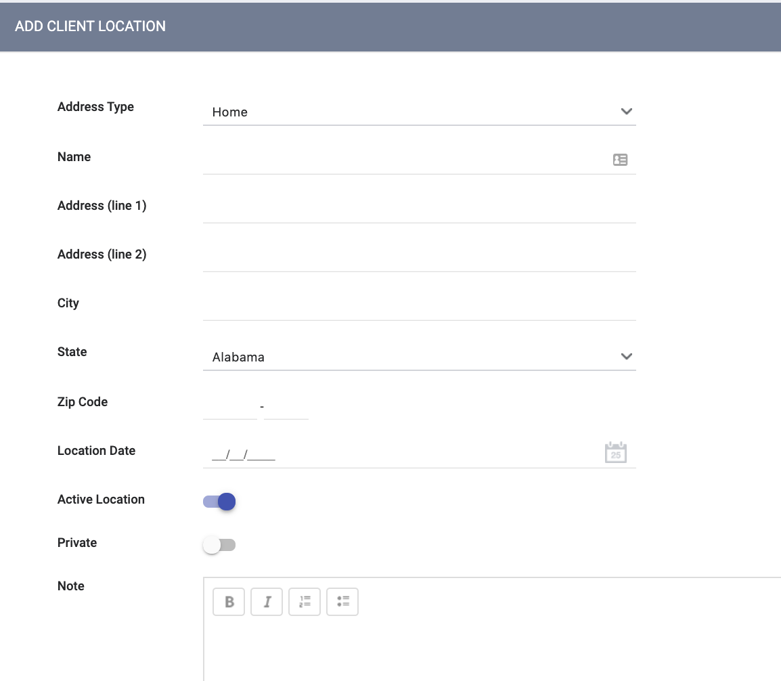
Update the Location Tab
Location can be added manually or by using the GPS icon.
The active toggle should be turned on to indicate the client’s current location.
Notes:
The location tab is especially useful for outreach teams. It can be used to locate clients easily. You have the option to manually enter an address or use the GPS icon to pinpoint an exact location.
You will want to mark the location an “active location” when it is the client’s current location. You can also turn off the “active location toggle” to indicate it is no longer a place the client is staying.

Slide 13
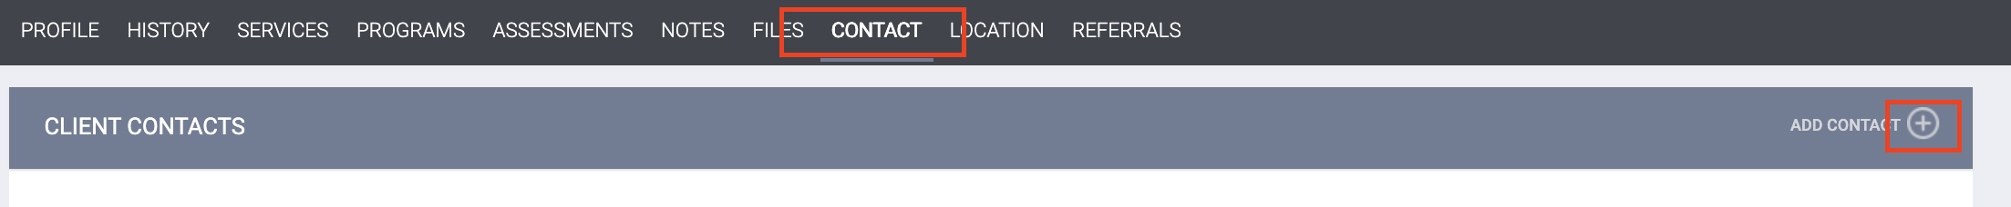
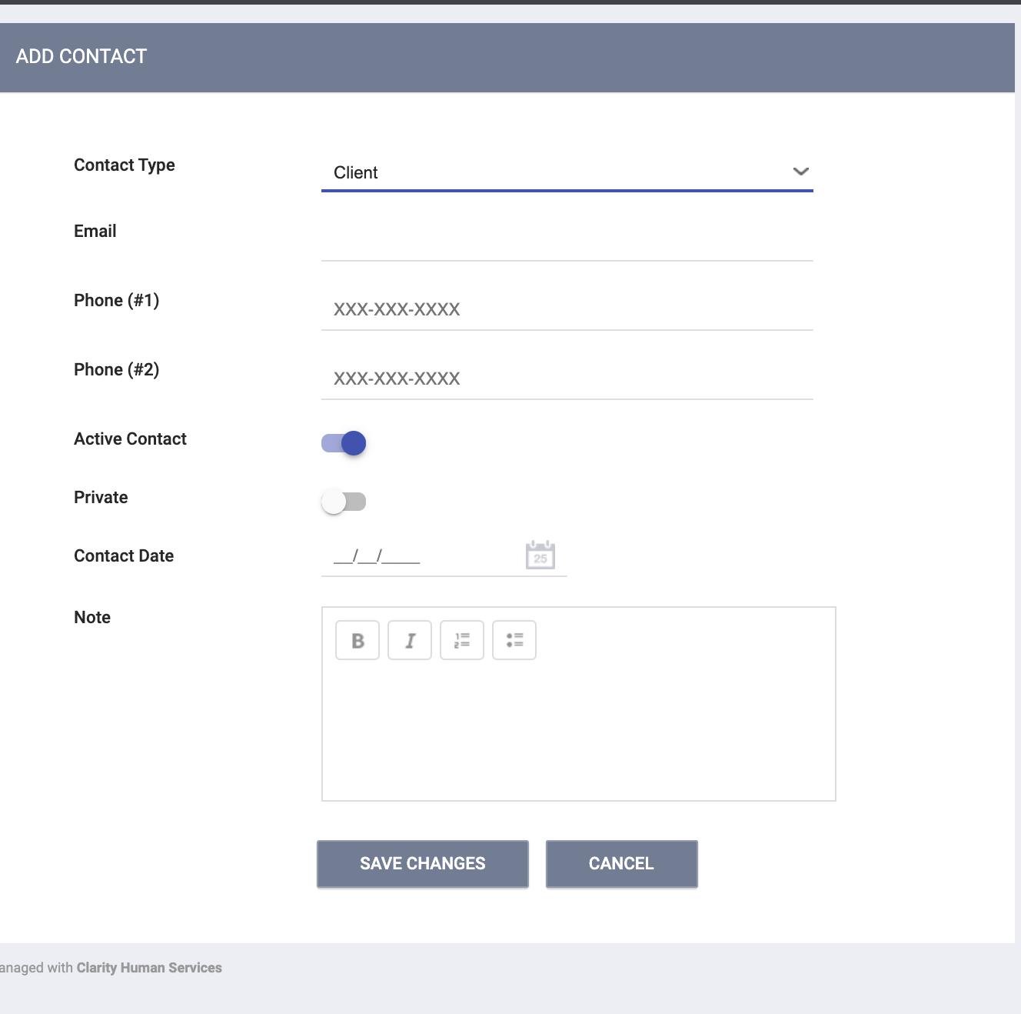
Update Contact Information
The active toggle should be turned on to indicate the client’s current location.
Add contact information for the client or people in their support system (case manager, family member, friend etc.)
Multiple forms of contact can be added.
Notes:
Contacts can be used to record contact information for the client or their support system. You will want to mark the contact an “active contact” when it is the client’s current contact information. You can also turn off the “active contact toggle” to indicate it is no longer a way to reach the client.

Slide 14
Program Enrollment

Slide 15
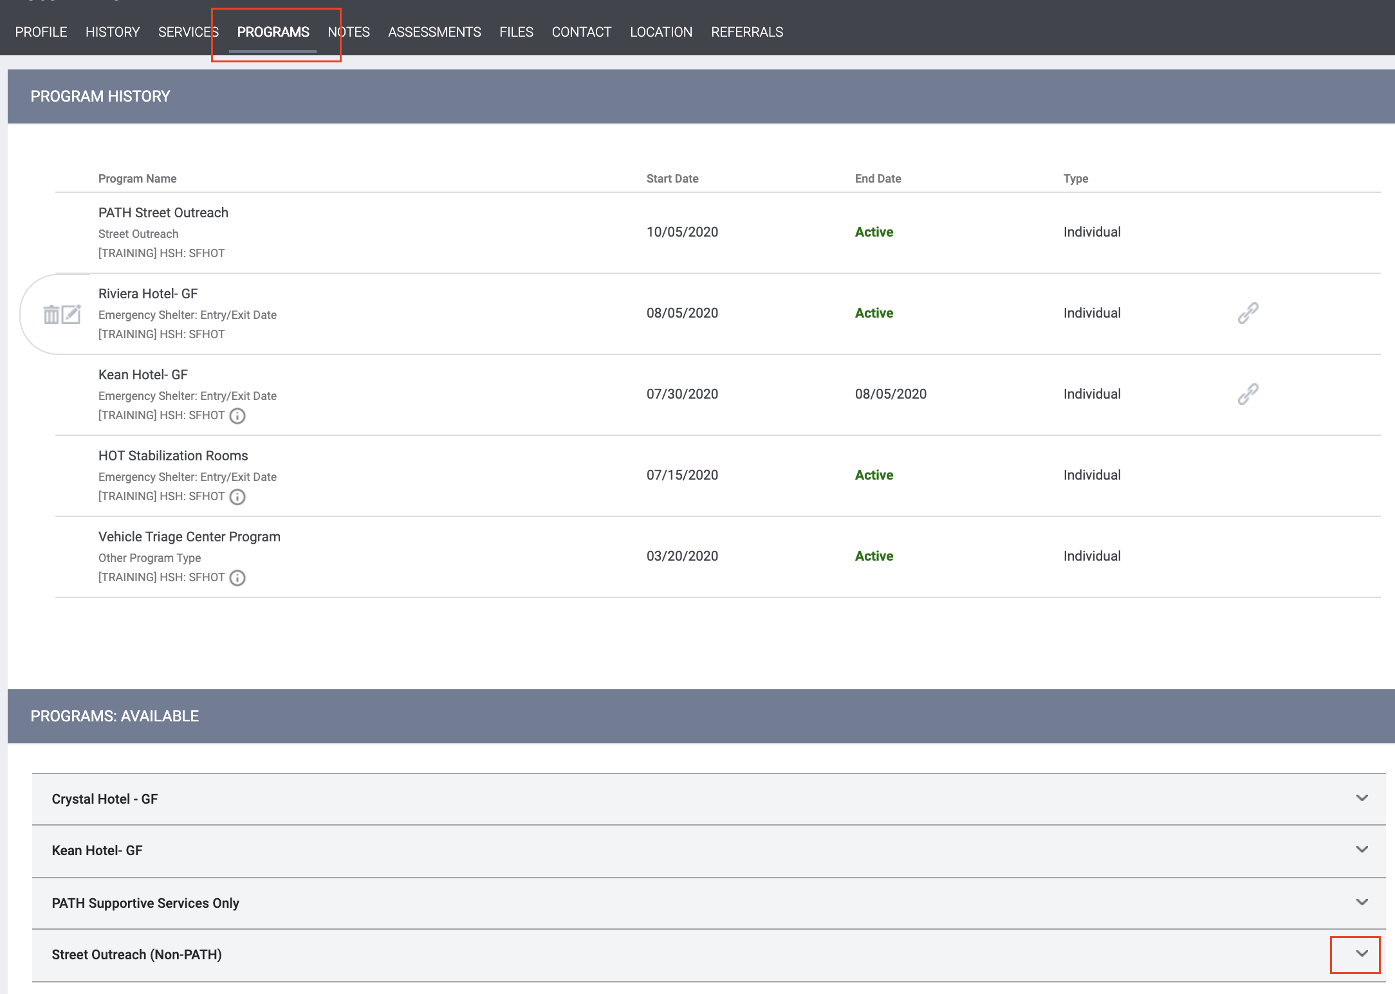
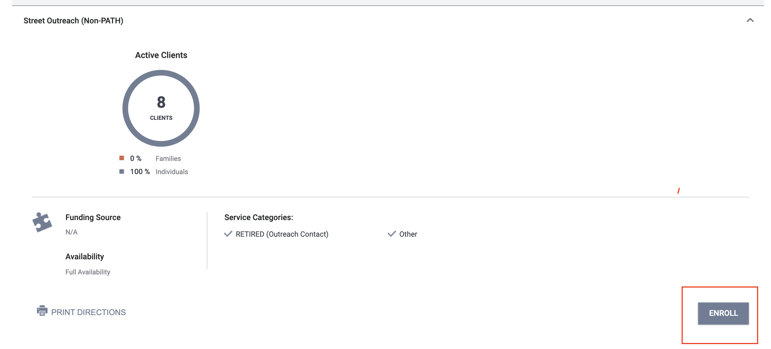
Program Enrollment
Outreach clients should be enrolled in the outreach program to indicate initial contact with a client.
Project Start Date is first date of Contact.
Notes:
An enrollment indicates the initial contact with a client. The project start date, also known as the enrollment date, should be the date of first contact with the client.
The other fields on this screen collect information about the client’s housing history, disabling conditions and income.

Slide 16
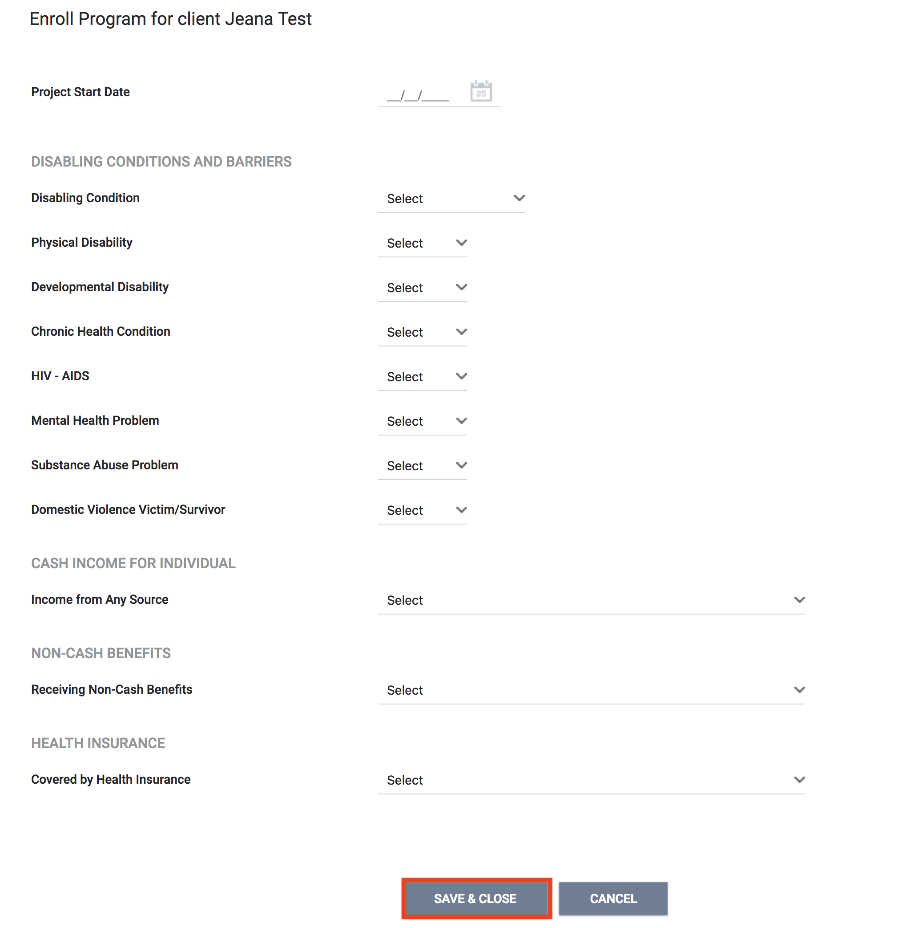

Program Enrollment
Please be sure to collect as much information as possible.
Avoid using “Client refused” or Data Not Collected” whenever possible.
Notes:
Please try to collect as much information as possible. Aggregate data for outreach programs is pulled into various federal reports like the System Performance Measures. We want to avoid using “Client refused” or Data Not Collected” whenever possible because it will affect the data completeness on the federal reports.

Slide 17
Date of Engagement
The date of engagement needs to be recorded on the enrollment screen.
  This date may be different than the date of enrollment.
  The enrollment can be edited at any time to record the Date of Engagement.
The point at which an interactive client relationship results in a deliberate client assessment or the beginning of a case plan.
This date may be on or after the Project Start Date.
If no intensive relationship with the client before exit, Date of Engagement should be left blank.
Only records with Date of Engagement counted in HUD Data Quality report(s).
Notes:
Outreach programs are required to collect the date of engagement. The date of engagement represents the point at which an interactive client relationship results in a deliberate assessment of the client or a beginning of a case plan.
The date of engagement may be a different date than the project start date.
If there was no intensive relationship with the client before exit, the Date of Engagement should be left blank.
Only records with Date of Engagement counted in HUD Data Quality report(s).

Slide 18
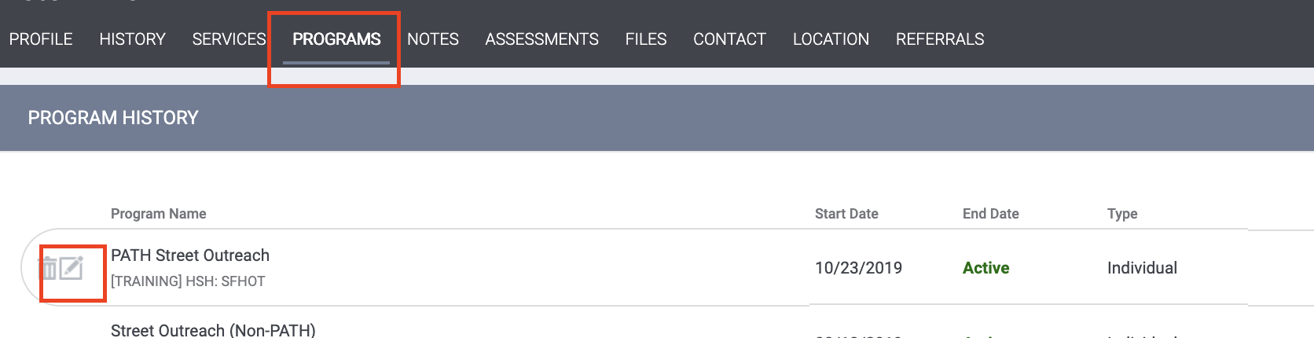
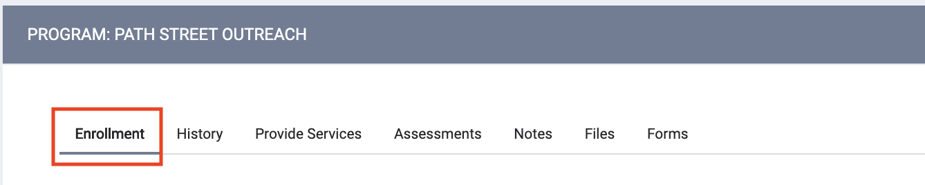
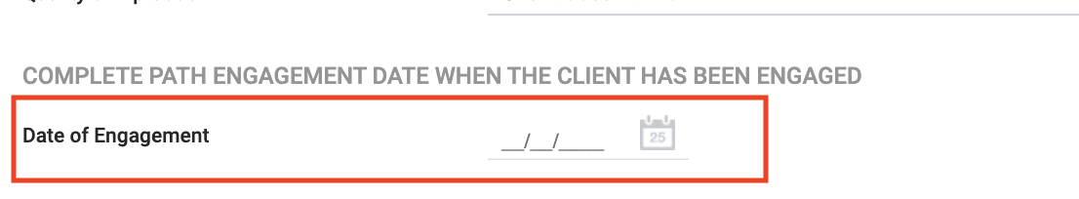
Date of Engagement

Slide 19
Current Living Situation

Slide 20
Current Living Situation Assessment
Required as part of the 2020 HUD Data Standards.
Used to regularly document the following:
  The current living situation of people experiencing homelessness
  Homeless chronicity
  To understand how many times a person is engaged while experiencing homelessness.
Notes:
The Current Living Situation is set up as an assessment in HMIS. This is a HUD requirement and replaces the old outreach contact that used to be required. The CLS is used to record the current living situation, homeless chronicity and level of engagement for people experiencing hoelessness.

Slide 21
Current Living Situation Assessment
The Current Living Situation should be recorded:
At the time of program enrollment
At every direct contact with a client
  Complete a new assessment each time; do not edit the old assessment
If a Current Living Situation is completed by an outreach or shelter, it can be used as a homeless verification.
“A contact is defined as an interaction between a worker and a client designed to engage the client. Contacts include activities such as a conversation between the worker and the client about the client's well-being or needs, an office visit to discuss their housing plan, or a referral to another community service”.
Notes:
THE CLS must be recorded at program enrollment and at every direct contact with a client. You will want to create a new assessment each time. You should NOT be editing an old one.

Slide 22
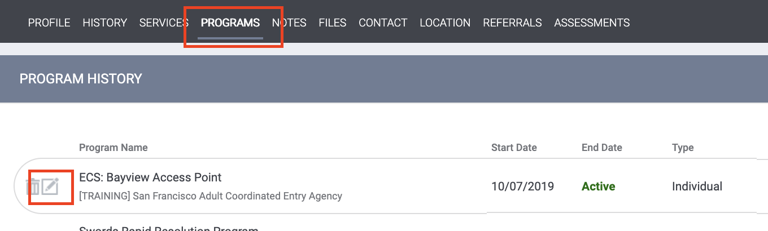
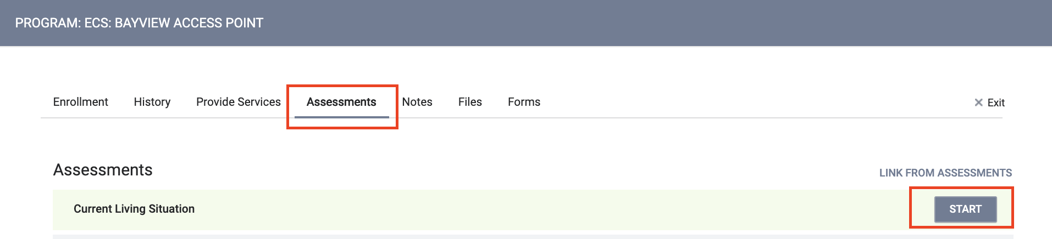
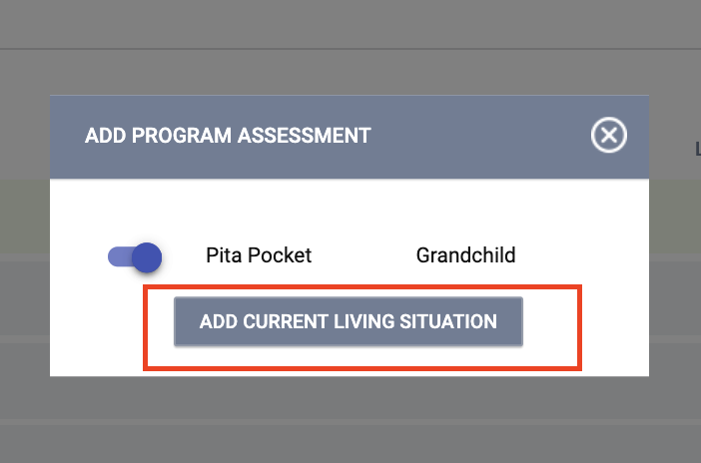
Current Living Situation Assessment

Slide 23
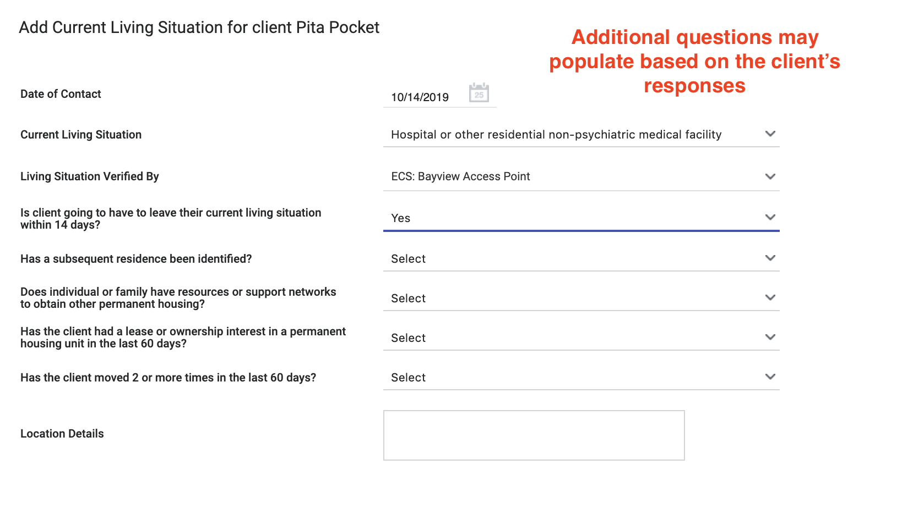
Current Living Situation Assessment
The “Living Situation Verified By” field should only be completed if the client’s living situation was verified by a entity not participating in HMIS.
  This would be rare for outreach teams so this field will usually be left blank.
Notes:
The “Living Situation Verified By” field should only be completed if the client’s living situation was verified by a entity not participating in HMIS.
This would be rare for outreach teams so this field will usually be left blank.

Slide 24
Program Exit

Slide 25
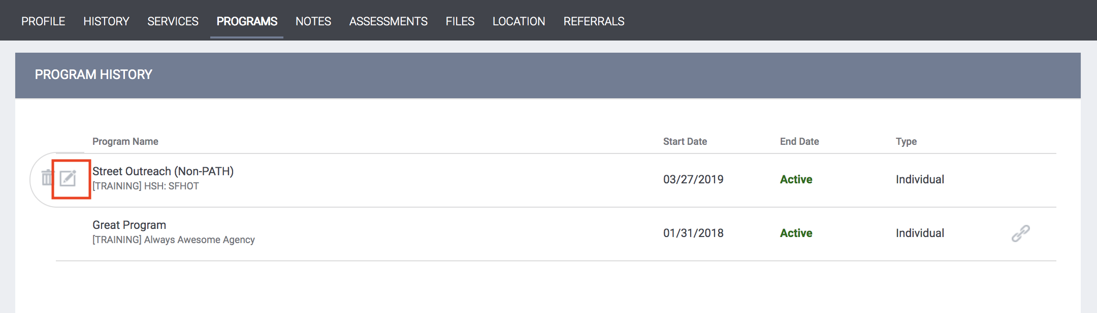
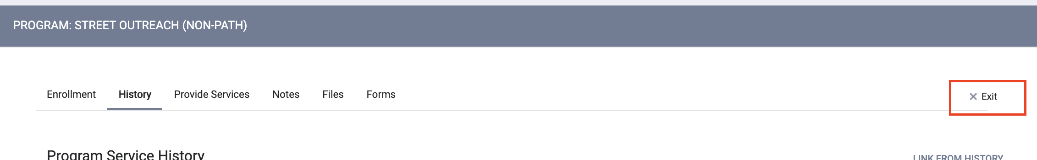
Program Exit
Exits should occur if the client refuses services, client is deceased, or client has not engaged for 180 days (six months).
    If the client resurfaces, you can complete a new enrollment.
Notes:
Clients should be exited from the program if the client refuses services, client is deceased, or client has not engaged for six months.
. Outreach programs tend to leave clients enrolled longer than other programs because the level of client engagement may ebb and flow.
Information from the enrollment screen will carry forward to the exit screen automatically. You will want to verify the information is still up to date and make any changes needed.

Slide 26
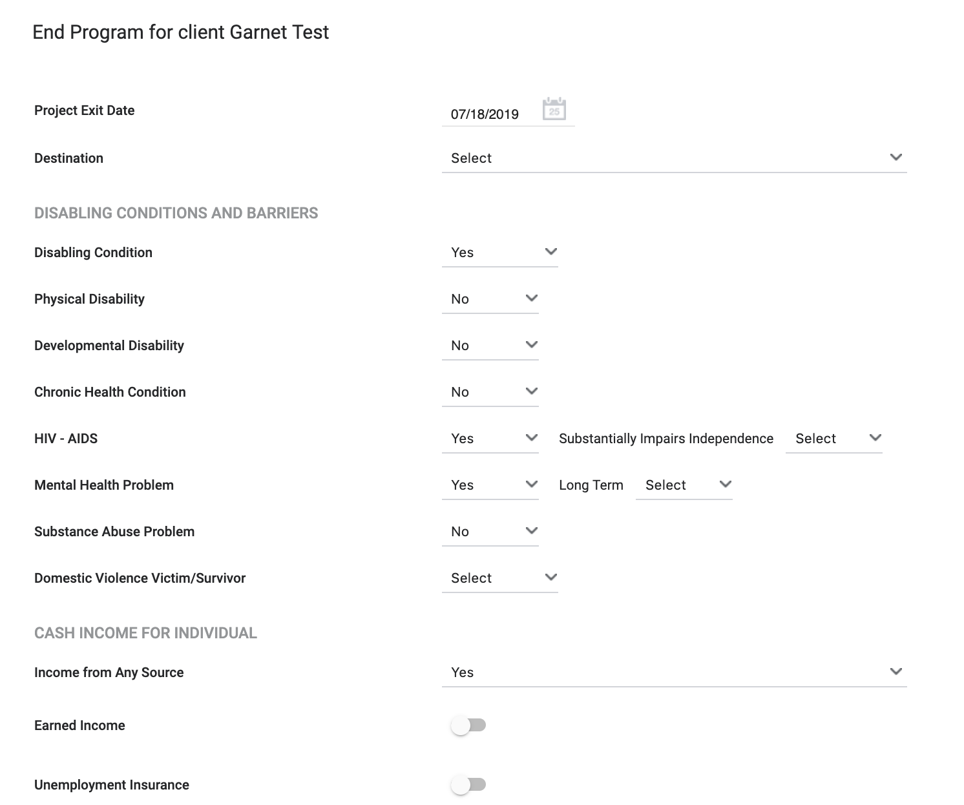
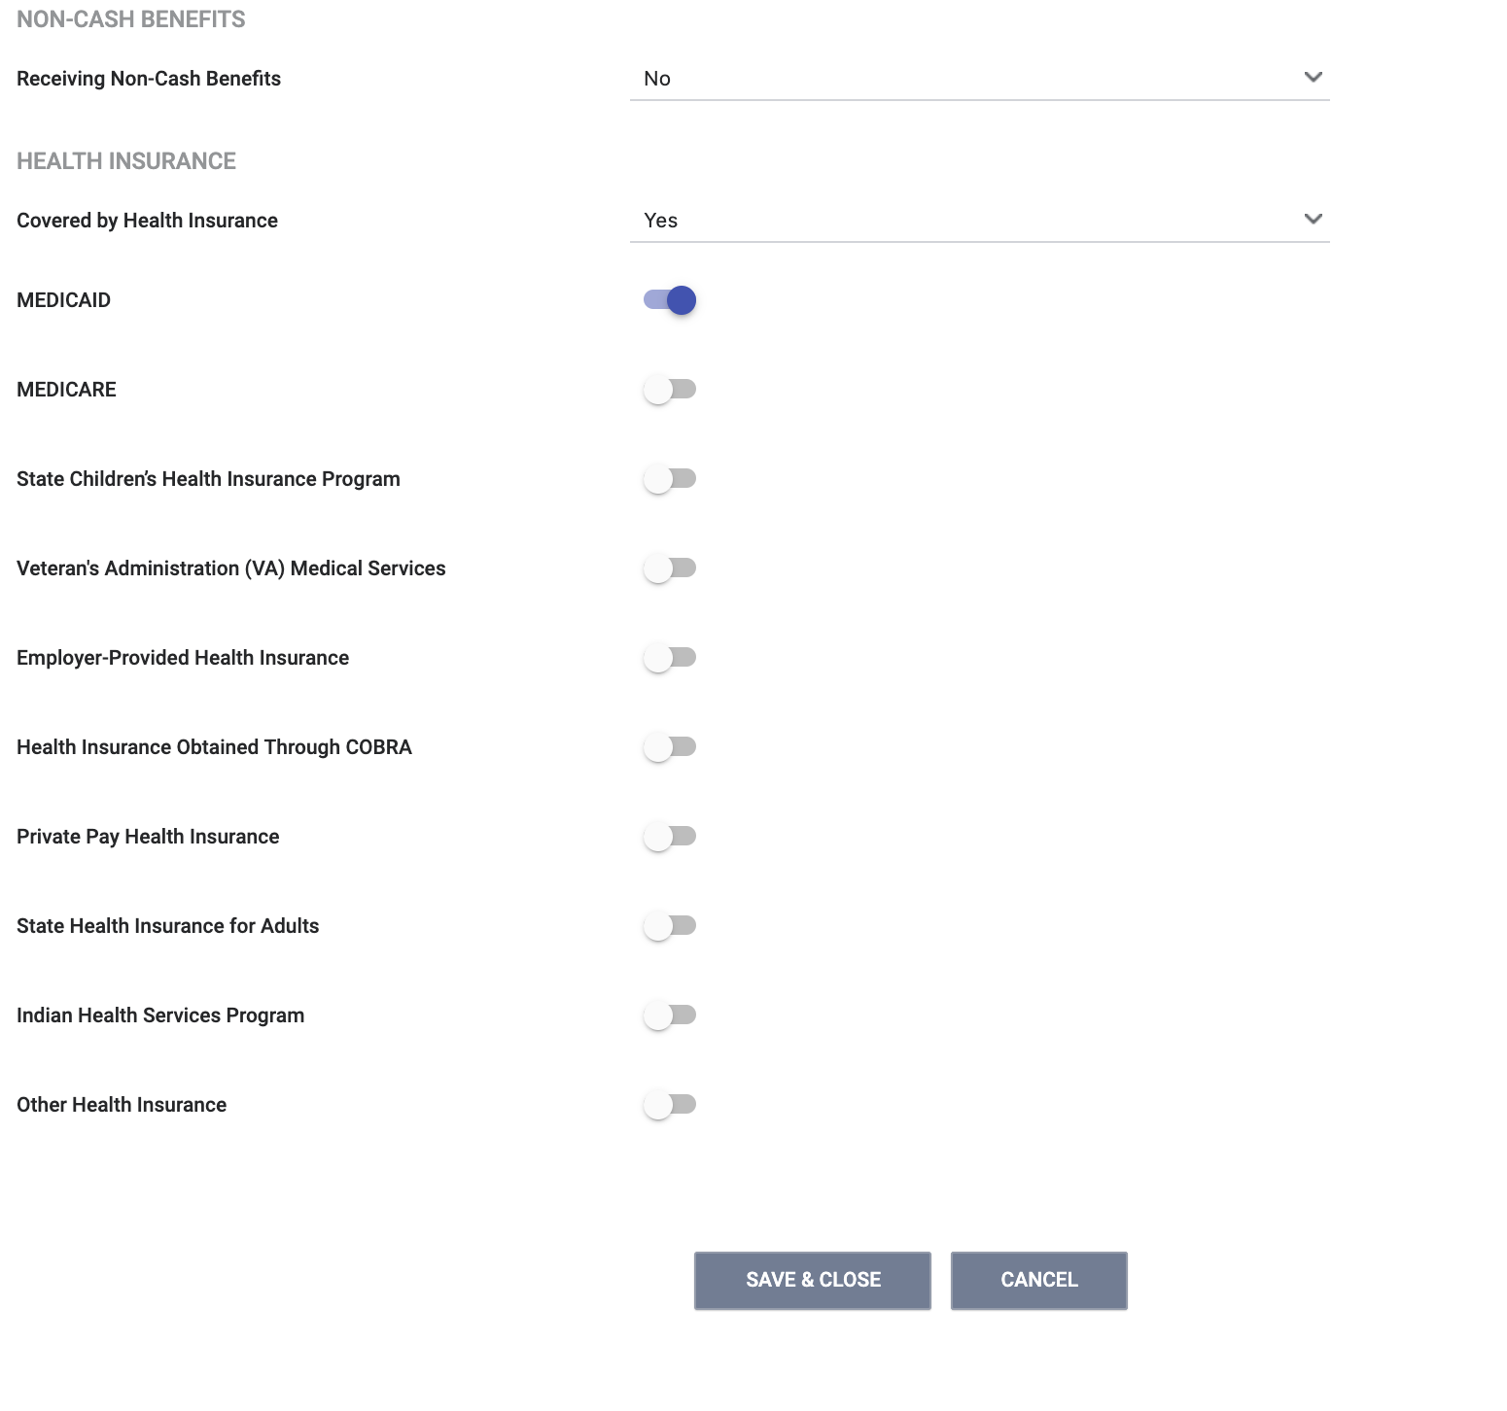
Program Exit
Complete all fields in the exit form and click “Save and Close”

Slide 27
Reports

Slide 28
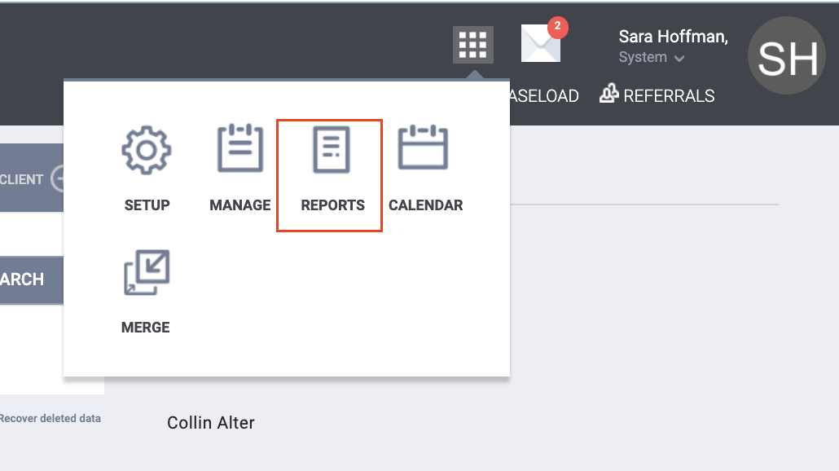

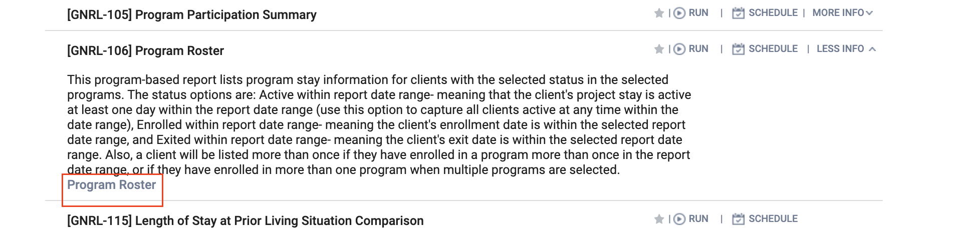
Reports
You can access reports through the launcher.
“More info” will provide a summary about the report and link you to a Help Desk article with additional information.
Notes:
You can access reports through the launcher.
“More info” will provide a summary about the report about the report and link you to a Help Desk article with additional information.

Slide 29
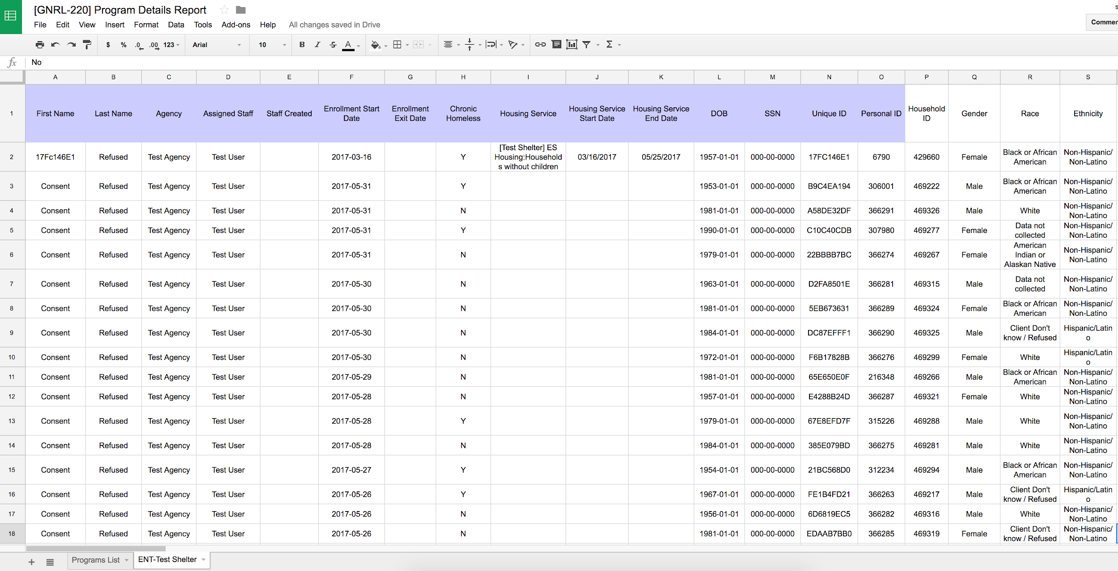
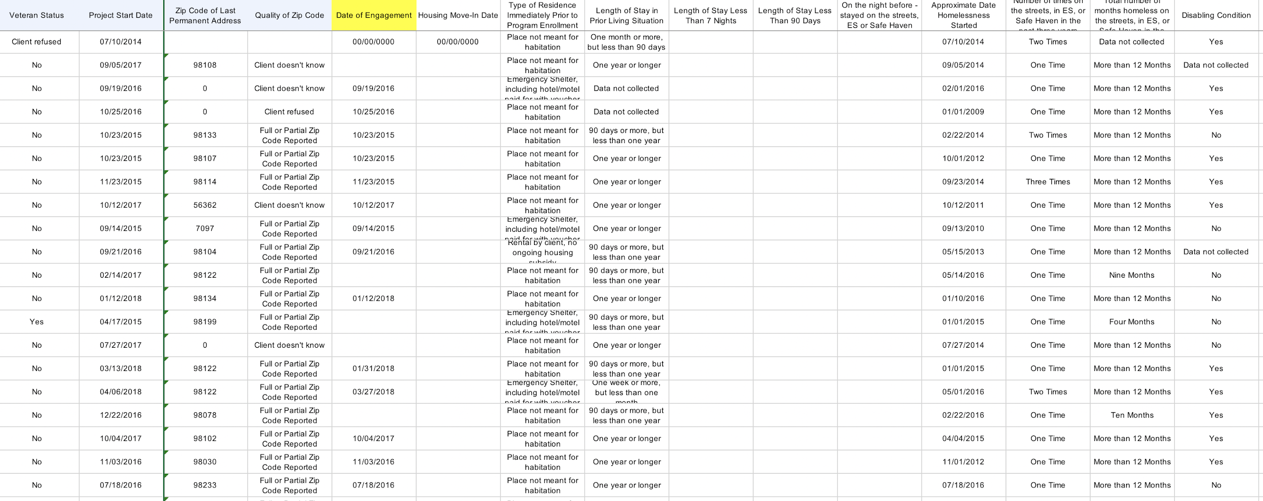
[GNRL-220] Program Details Report
Review for Date of Engagement.
Review for chronic homeless status elements (shows all data entered on entry/exit screens).
Useful for reviewing data accuracy and completeness.
Notes:
Review to make sure the date of engagement has been entered where applicable.
Shows you the client’s CH status. The information for that indicator is pulled from date on entry and exits screen that have been completed for the client.

Slide 30
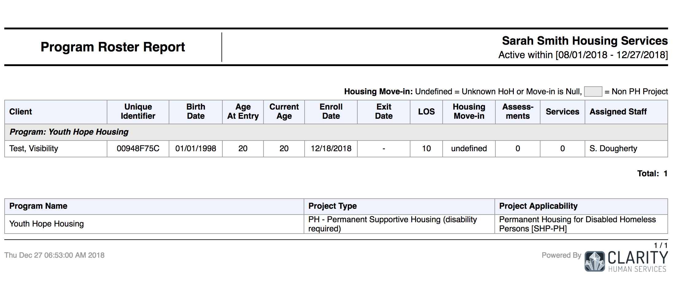
[GNRL-106] Program Roster
[GNRL-106] Program Roster (Program Based Report)
  Who’s stayed in the program
  Lists program stay information for clients with the selected status in the selected program
Notes:
The program roster is a great report to get a snapshot of who is currently enrolled in the program or who was enrolled for a specific time period. It is a great report for supervisors and staff to monitor the program and make sure rosters are being kept up to date.

Slide 31
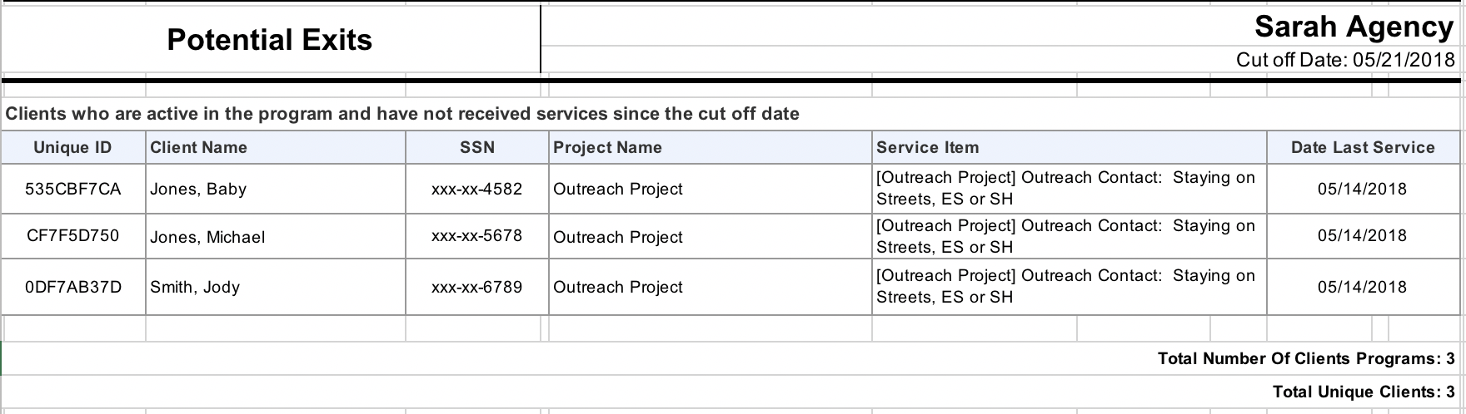
[EXIT-101] Potential Exits
Report shows clients who have not engaged since the “cut off date” you selected.
Displays the last service, case notes, or “update” the client received and the date.
  “Updates” include the Current Living Situation.
Notes:
Potential Exit report is a way to see what clients may need to be exited due to long periods of no engagement. The report let’s you select a “cut off date”. So if you want to see, which clients have not had any engagement for 180 days, you would set the cut off date as 180 days prior to today. So if today was Feb. 8th, and you want to see who hasn’t had any contact for 180 days, you would set the cut off date to Aug 8th, 2020.
The report will give you a list of clients who haven’t had a CLS, an enrollment, case notes, services, for this program for 90 days. That list of clients would be clients you may want to consider exiting.

Slide 32
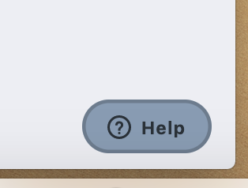
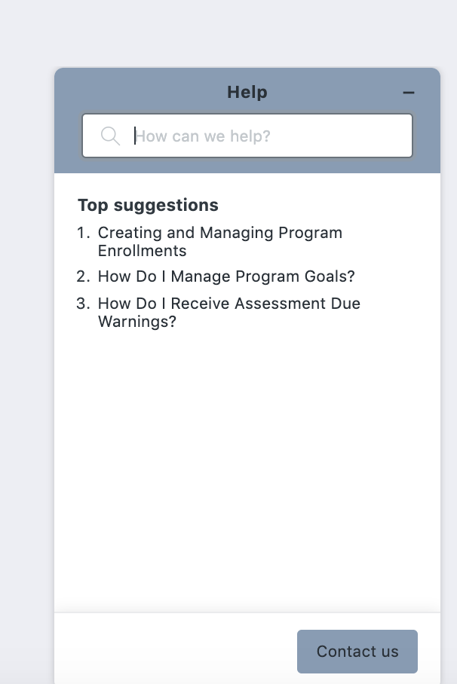
Resources
The Help Desk Widget
Bitfocus Help Desk
marin@bitfocus.com or (415) 429-4211
Marin Help Center Web Page
https://marin.bitfocus.com

